Slide 1

Market price prediction
Machine learning internship
Samuel MATIA

Slide 2

Project presentation
The primary objective of this project is to develop a robust time series machine learning model capable of
accurately forecasting market trends based on historical data. By leveraging advanced algorithms, we aim
to predict the quantity and prices of commodities for future months, empowering stakeholders to make
proactive decisions regarding production, procurement, pricing strategies, and resource allocation.

Slide 3
The dataset comprises the following columns:
•
-market: The market or commodity under consideration.
-month: The month for which the data is recorded.
-year: The year corresponding to the recorded data.
-quantity: The quantity of the commodity traded or available.
-priceMin: The minimum price of the commodity during the month.
-priceMax: The maximum price of the commodity during the month.
-priceMod: The mode or most frequently occurring price of the commodity during the month.
-state: The state or region where the market is located.
-city: The city where the market is situated.
-date: The specific date of the recorded data.
Dataset overview

Slide 4
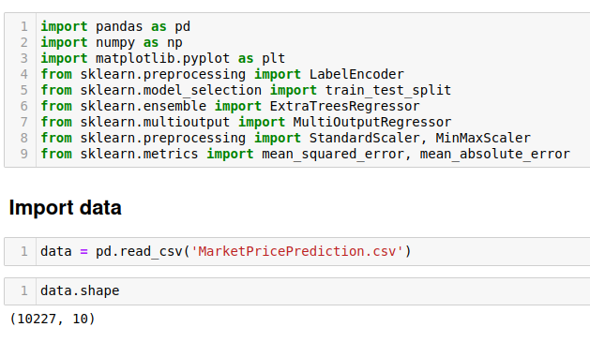
Data shape

Slide 5
Preprocessing
Label encoding
Standardisation
Feature engineering : create new columns for forecasting with prev datas

Slide 6
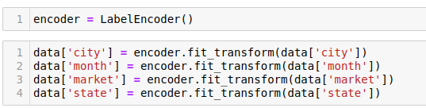
Label Encoding

Slide 7
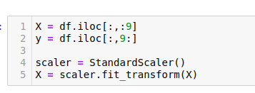
Standardisation

Slide 8
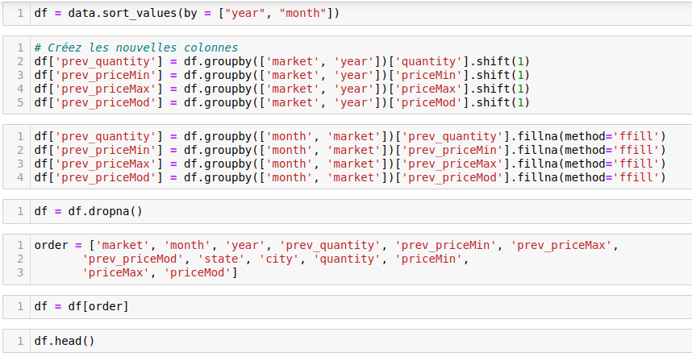
Create new columns with prev data for the same market

Slide 9
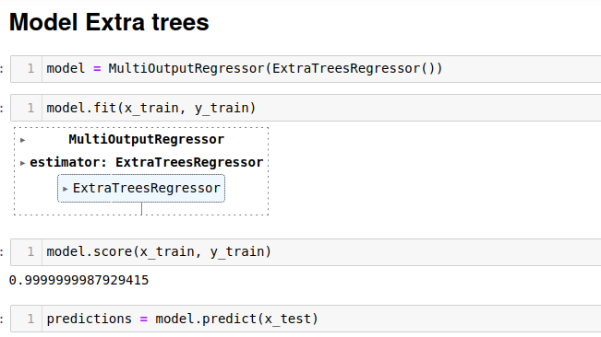
Model

Slide 10
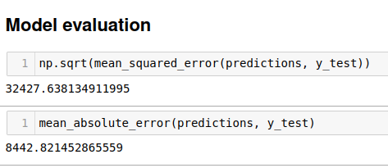
Metrics

Slide 11
Machine learning internship
Samuel MATIA

